Slide 1
Investigation of a gel effect on dental disease by Generalized Linear Model
Lingdi Zhang
09-12-2018

Slide 2
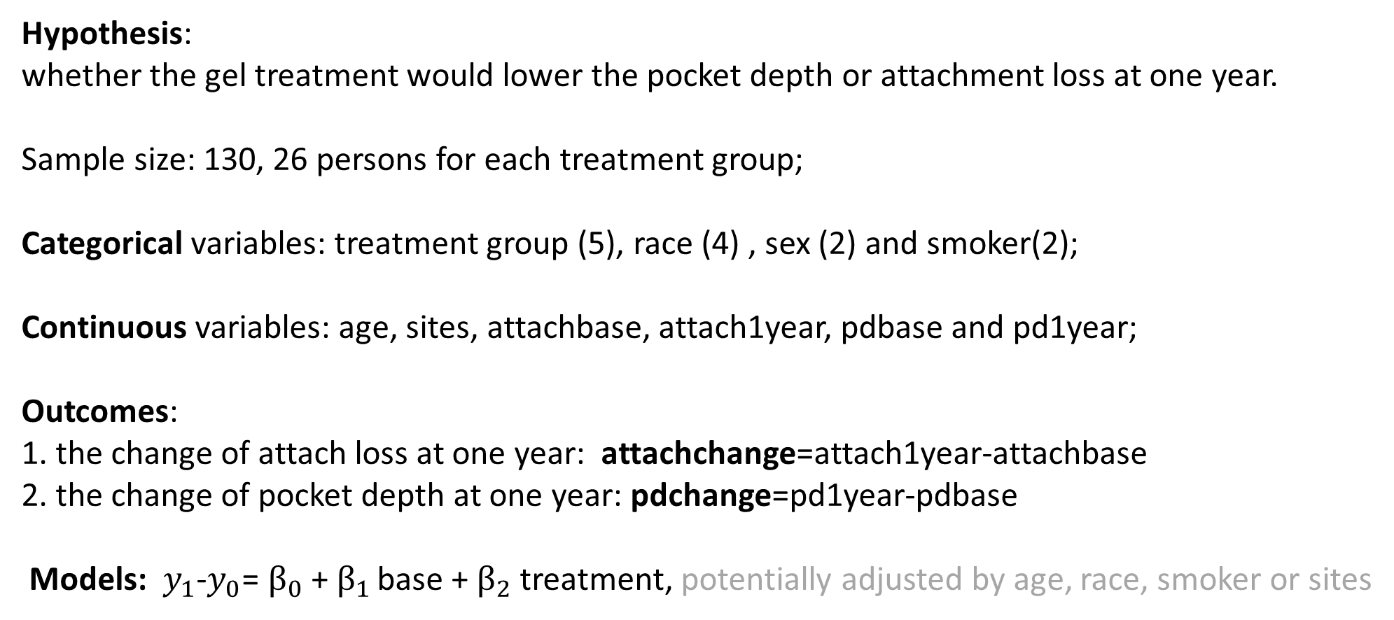
Introduction of dataset
Hypothesis:
whether the gel treatment would lower the pocket depth or attachment loss at one year.
Sample size: 130, 26 persons for each treatment group;
Categorical variables: treatment group (5), race (4) , sex (2) and smoker(2);
Continuous variables: age, sites, attachbase, attach1year, pdbase and pd1year;
Outcomes:
1. the change of attach loss at one year: attachchange=attach1year-attachbase
2. the change of pocket depth at one year: pdchange=pd1year-pdbase
Models: $y_{1}$-$y_{0}$= $β_{0}$ + $β_{1 }$base +${ β}_{2}$ treatment, potentially adjusted by age, race, smoker or sites

Slide 3
Statistical descriptions of the dataset
1. correlation
New outcome:
Attachchange
pdchange

Slide 4
Statistical descriptions of the dataset
2. Missing data
3. Mean for continuous variables

Slide 5
4. Frequency for categorical variables

Slide 6
The analyzed result by GLM and t-teat
treatment | P-value | treatment | P-value
Trt1&2 | 0.0883 | Trt2&3 | 0.0174
Trt1&3 | 0.3706 | Trt2&4 | 0.0096
Trt1&4 | 0.2733 | Trt2&5 | 0.5735
Trt1&5 | 0.3981
Trt1: Placebo
Trt2: control
Trt3: Low concentration active ingredient gel
Trt4: Medium concentration active ingredient gel
Trt5: High concentration active ingredient gel

Slide 7
Conclusion and Limitation
GLM of attachchange
GLM of pdchange
From above results, adjusted by demographic factors, the new gel had no significant effect on the treatment population, and was not promising to test for clinical trial. But baseline may affect attach loss (p<.0001), and sex may affect pocket depth (p=0.049).
If the population increased, the model might be more accurate and the clinical significance might be much better addressed. It was difficult to impute the accurate values for the missing data since there was only one year data point and did not know the reason for loss of following up.

